Slide 1
Professor
Jorge Alfonso Meléndez Acuña

Slide 2
Welcome

Slide 3
Schedule
Network Science for Data Analytics
Unit 1
Introduction to Network Analysis
Unit 2
Centrality
Measures
Unit 3
Introduction to Network Models
Unit 4
Community Detection
Unit 5
Error and Attack Tolerance
Unit 6
Graph Machine Learning
Introduction to
Data Science
Basic Concepts of Graph Theory
Hubs
Communities
Vulnerability in networks
Machine Learning with Graphs
Introduction to Network Science
Small Worlds
Network Models
Deep Learning with Graphs

Slide 4
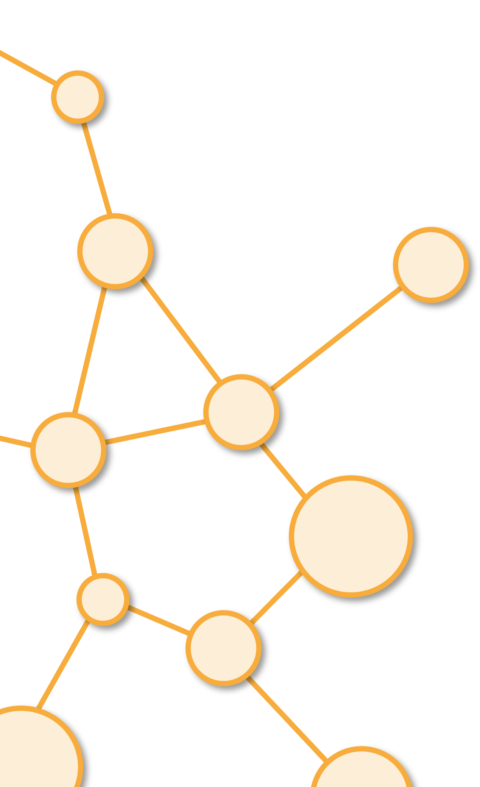
Community Detection
Unit 4

Slide 5
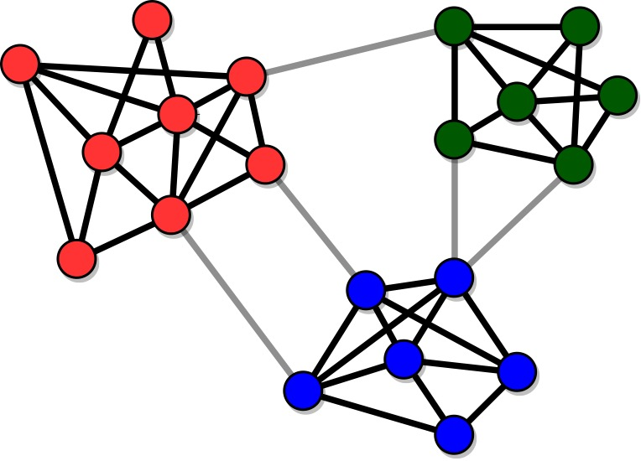
Community Structure
Communities (or clusters): sets of tightly connected nodes

Slide 6
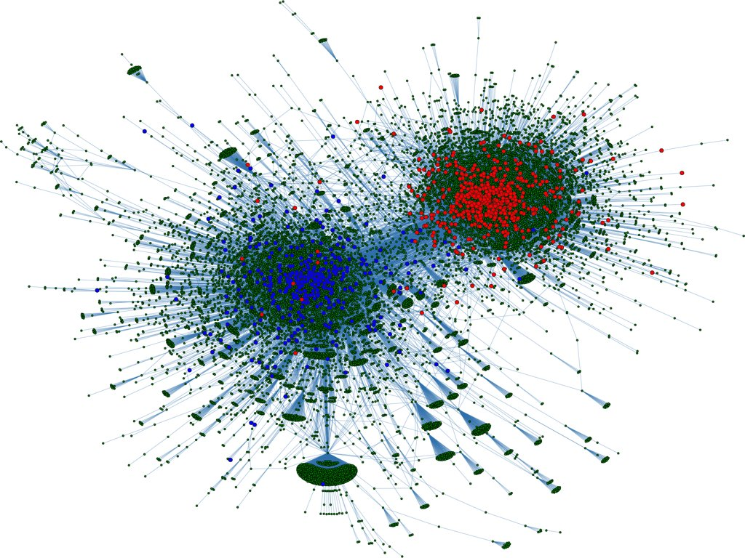
Community Structure
Example: Twitter users with strong political preferences tend to follow those aligned with them and not to follow users with different political orientation
Other examples: social circles in social networks, functional modules in protein interaction networks, groups of pages about the same topic on the Web, etc.

Slide 7
Why study Communities?
Uncover the organization of the network
Identify features of the nodes
Classify the nodes based on their position in the clusters
Find missing links

Slide 8
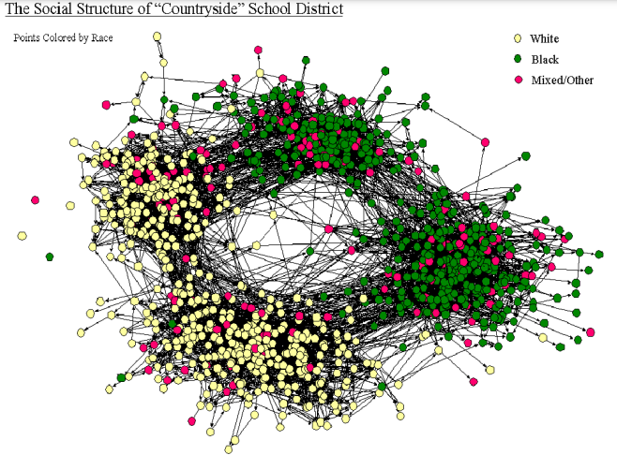
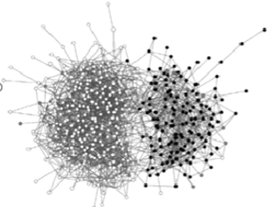
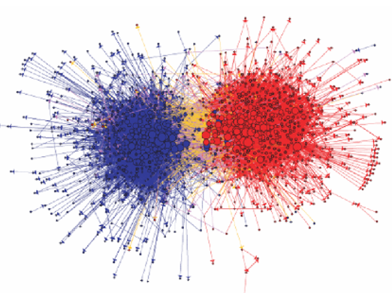
Homophily and Communities
When there is strong Homophily (Assortativity) There are Communities

Slide 9
Examples of Communities

Slide 10
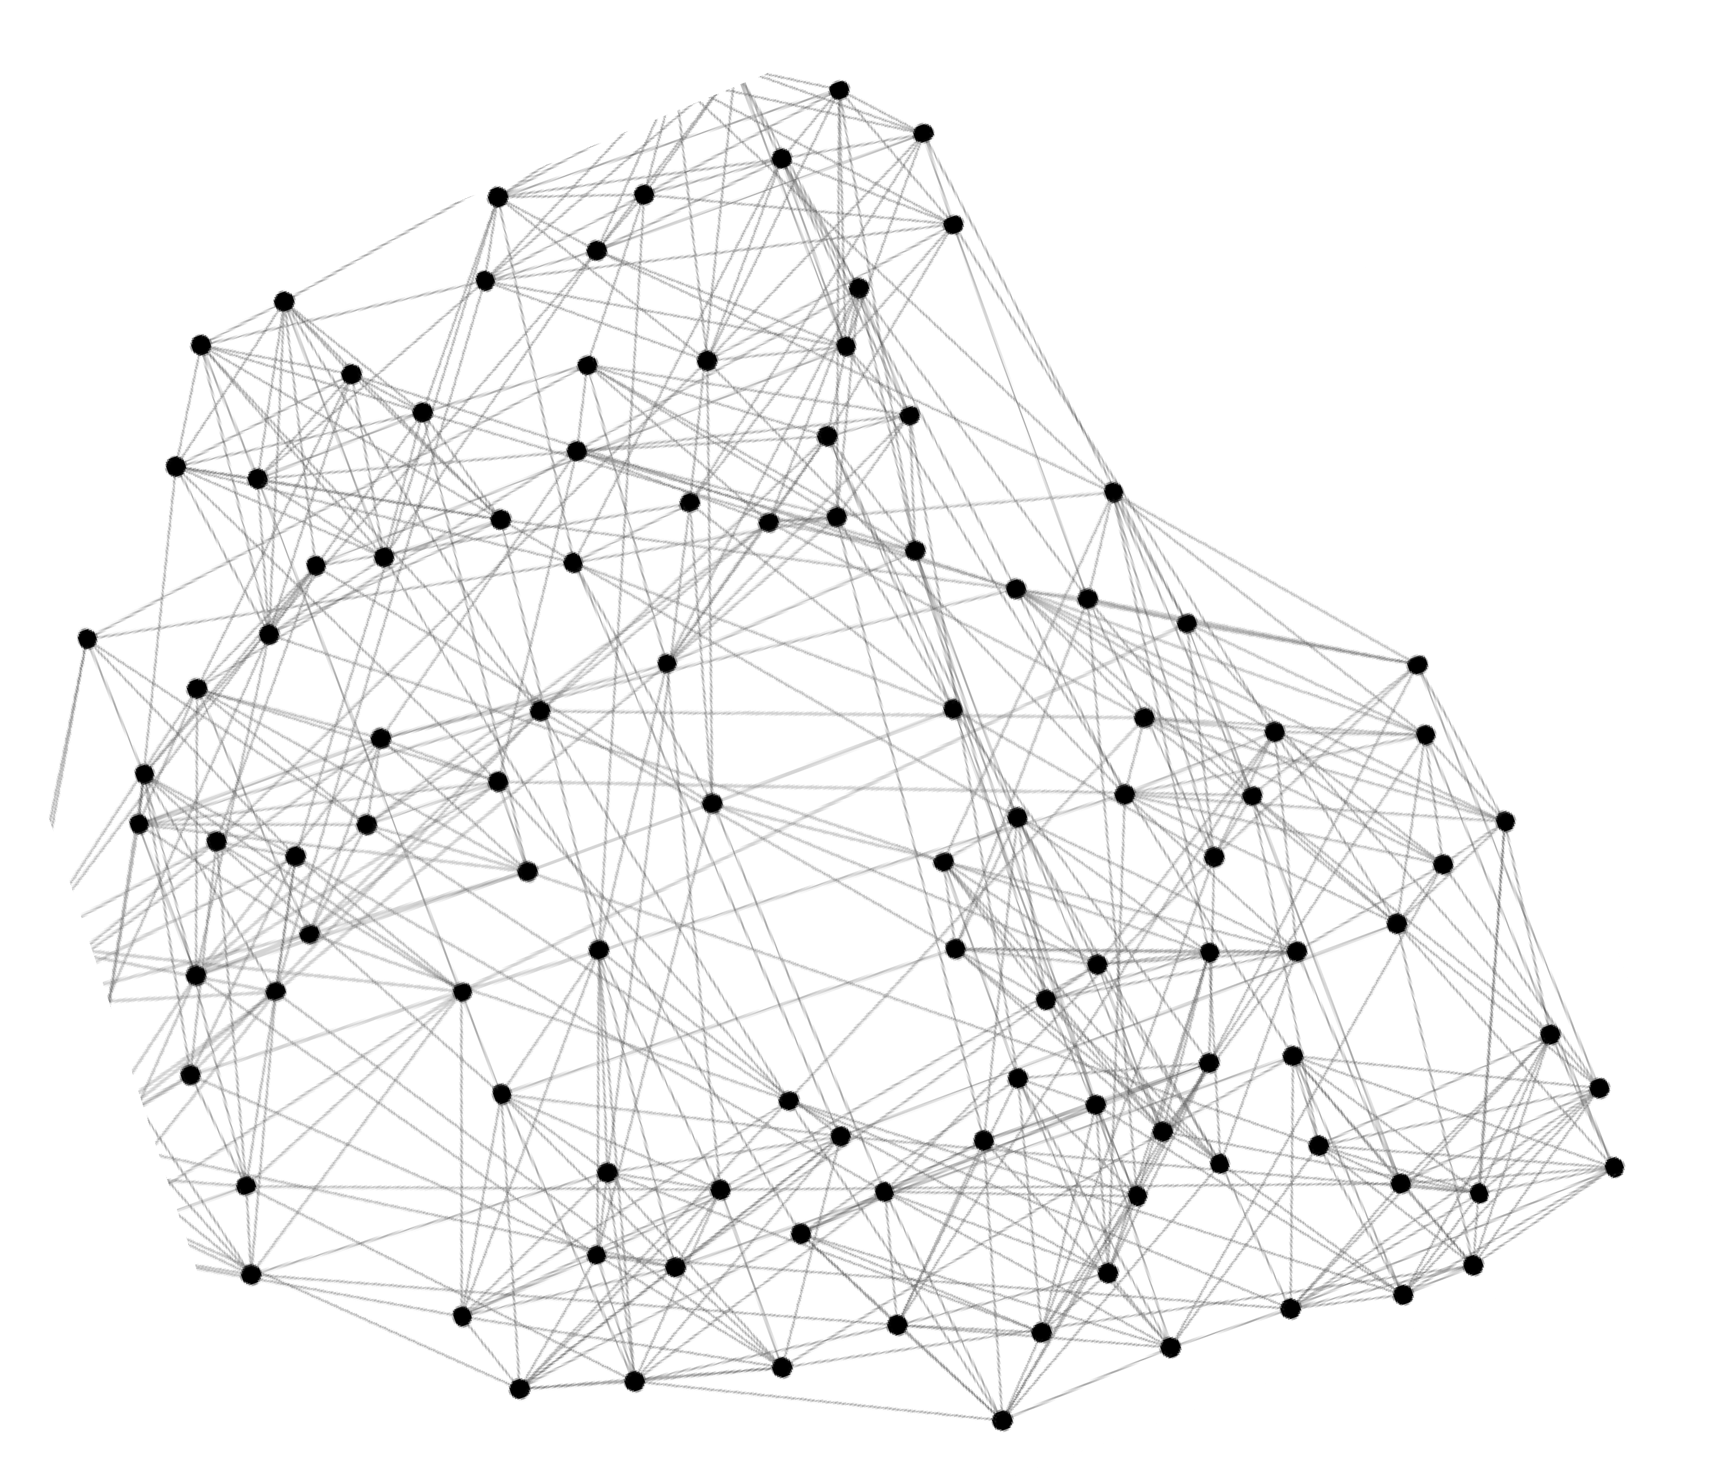

College Football
Can we identify node groups? (communities, modules, clusters)
Link to Model

Slide 11
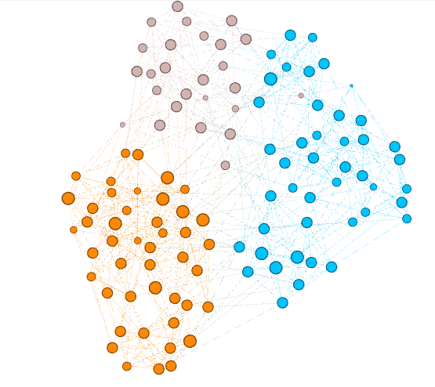
College Football
Yes there are hundreds of algorithms
Link to Model

Slide 12
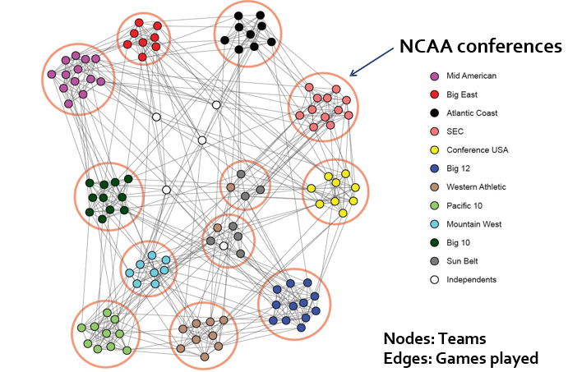
College Football

Slide 13
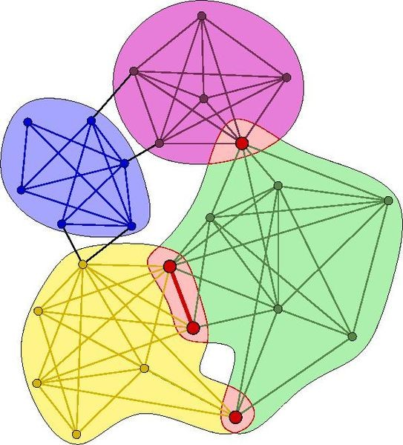
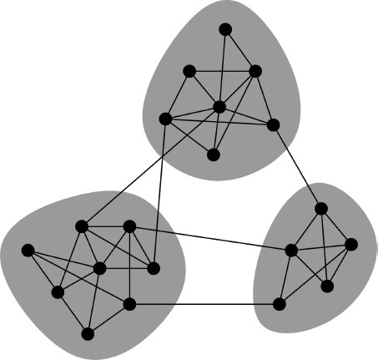
Overlapping Communities
Non-overlapping vs. Overlapping communities

Slide 14
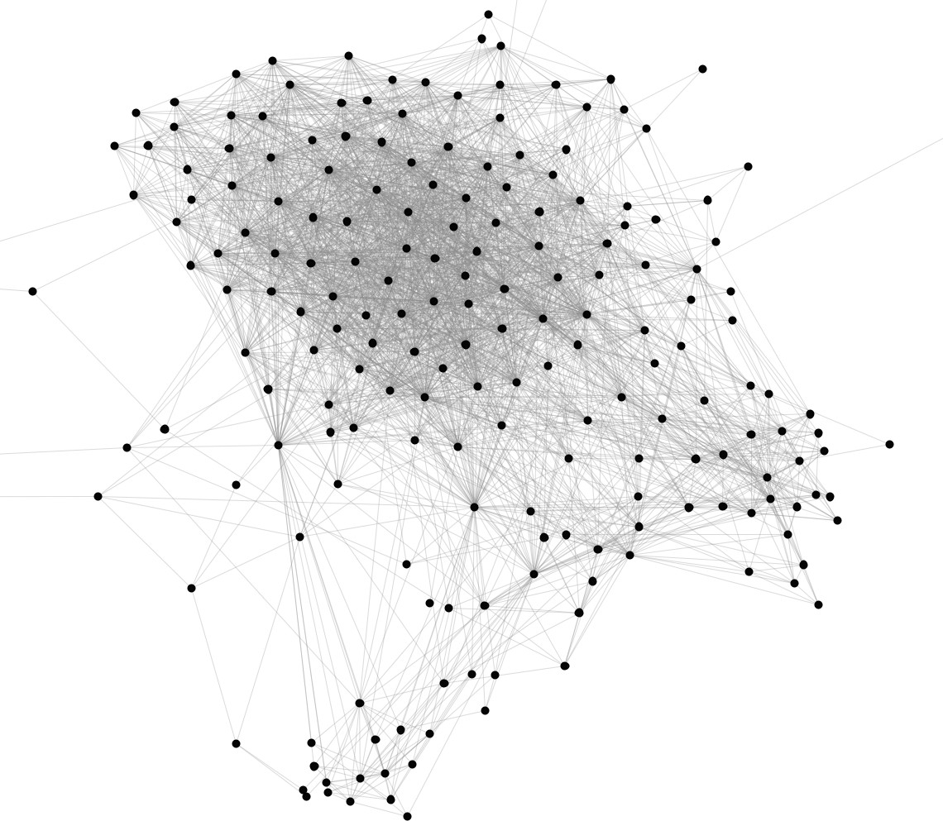
Facebook Ego
Can we identify node groups? (communities, modules, clusters)

Slide 15
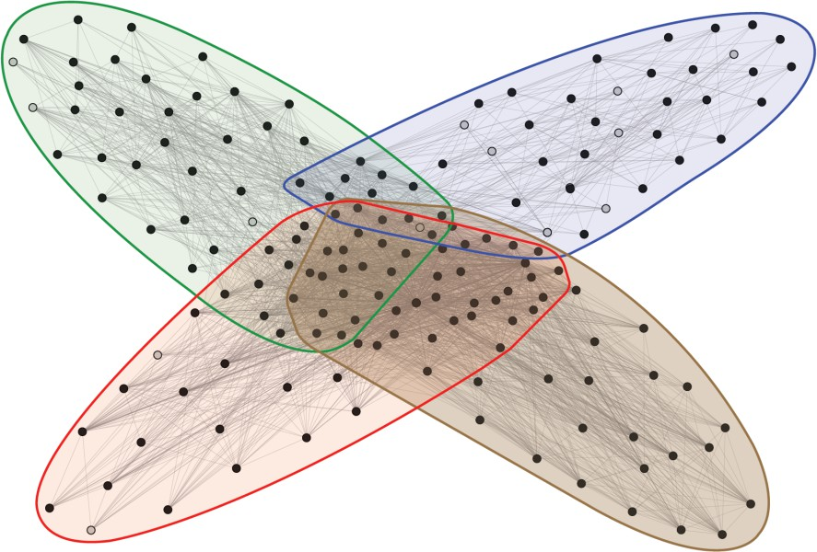
Student Stanford
Company
High School
Nodes: Users Edges: Friendships
Stanford (Basketball)
Stanford Squash
Social communities

Slide 16
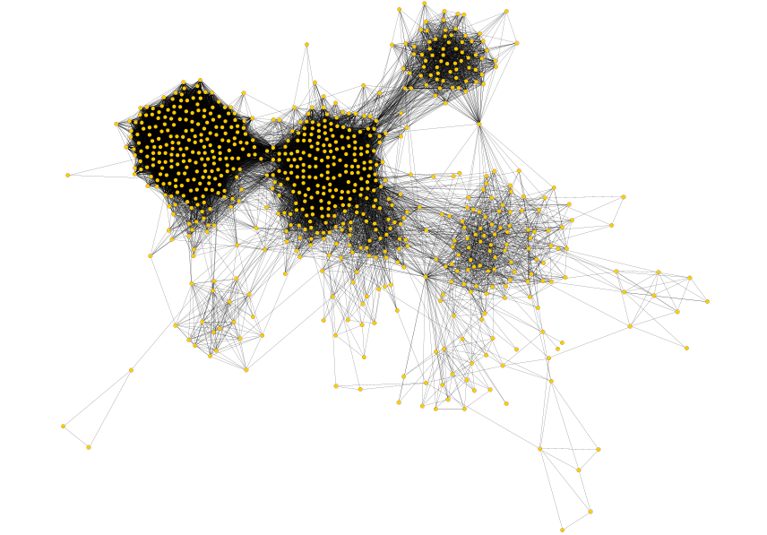
Real Example-SNAP-Leskovec
J. McAuley and J. Leskovec. Learning to Discover Social Circles in Ego Networks. NIPS, 2012.
Link to Model

Slide 17
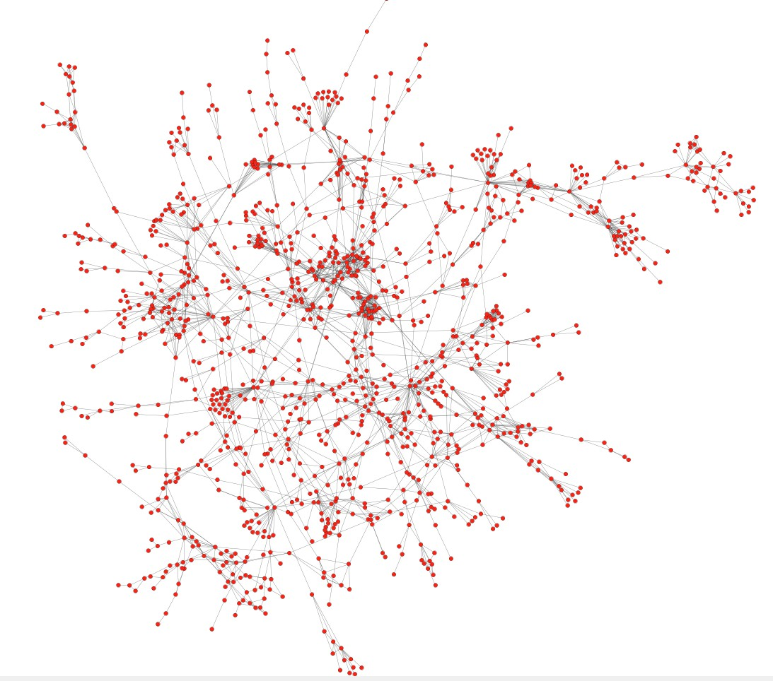
Protein-Protein Interactions
Can we identify functional modules?
Nodes: Proteins
Edges: Interactions

Slide 18
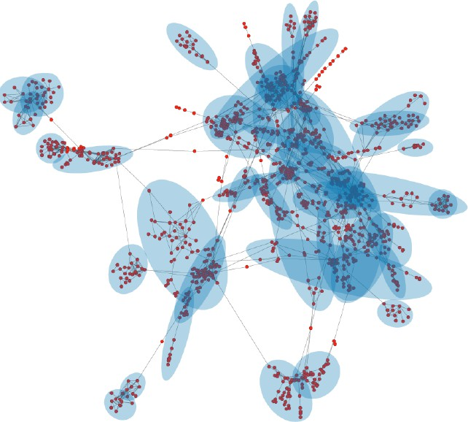
Protein-Protein Interactions
Nodes: Proteins
Edges: Interactions
Functional modules
Link to Model

Slide 19
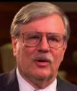
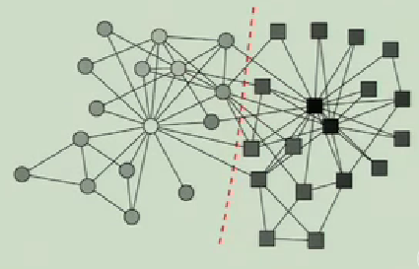
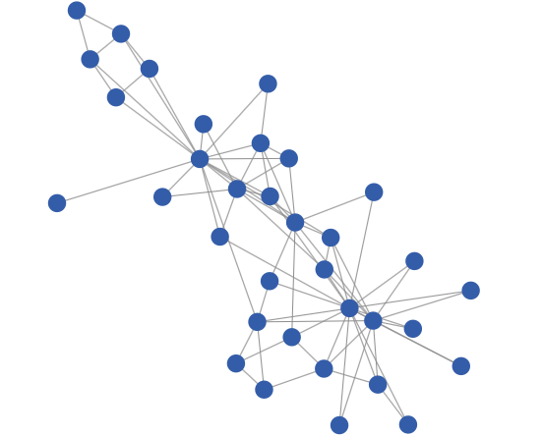
University Network
Karate Club Network
Communities in Social networks coincide with real social groupings
Wayne
Zachary
(1973)
Link to Model

Slide 20
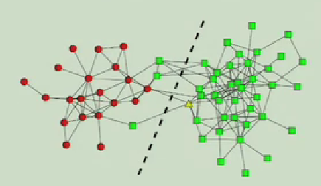
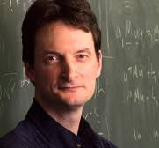
Animal Network
A lost Dolphin
Mark
Newman
Link to Model
Dolphin Network

Slide 21
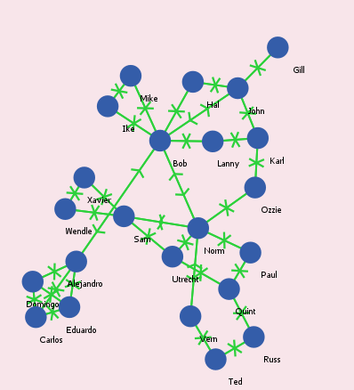
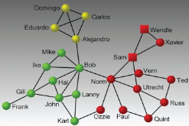
Strike
Importance of Informal Communication
Link to Model

Slide 22
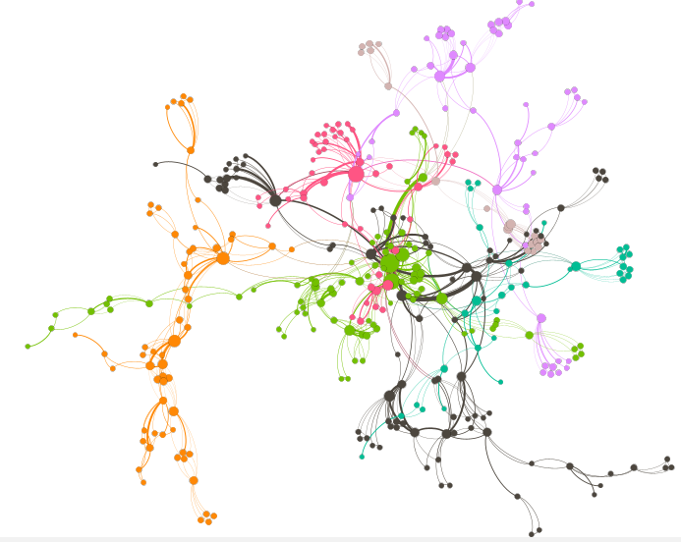
Net Science
Community of research works in Network Science
Citation Network
Link to Model

Slide 23
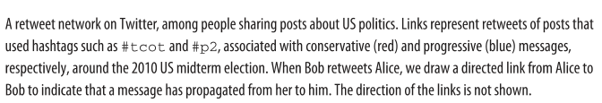

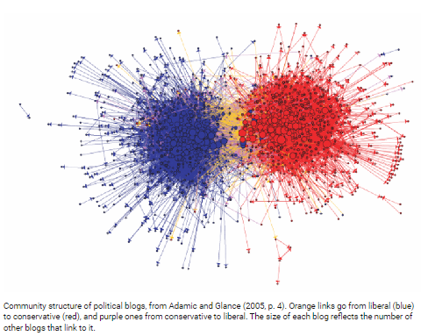
Political Tweets
Lada Adamic
Link to Model

Slide 24
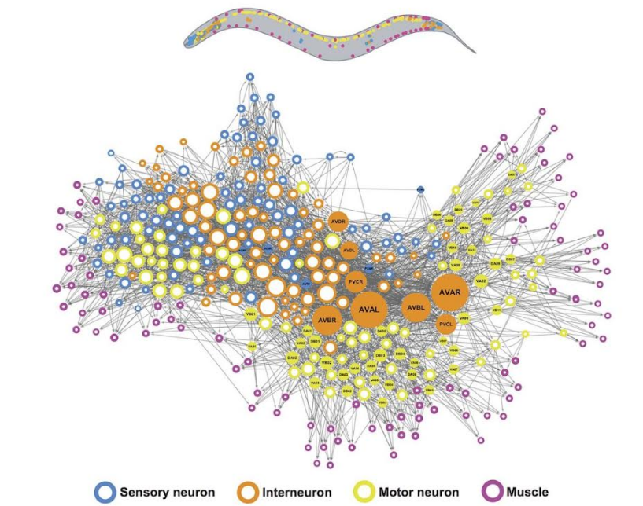
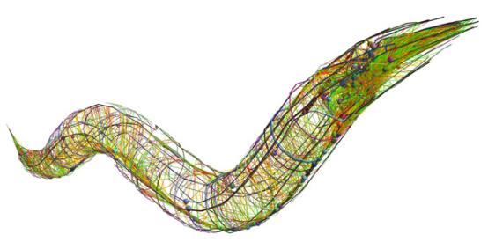
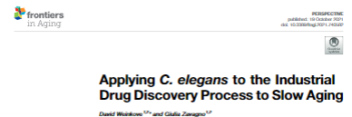
Brain of a Worm
Link to Model

Slide 25
Some Algorithms

Slide 26
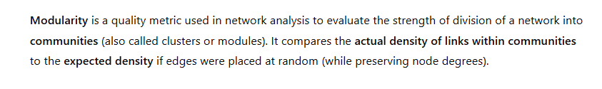
Modularity
Video Andrew Beveridge

Slide 27
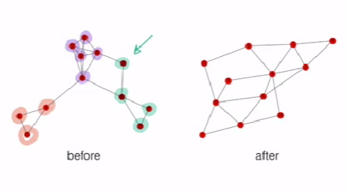
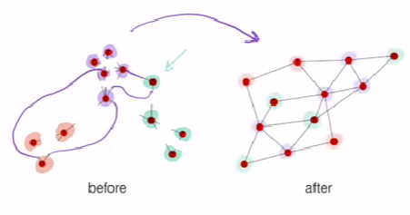
Random Wiring
Do it many times

Slide 28
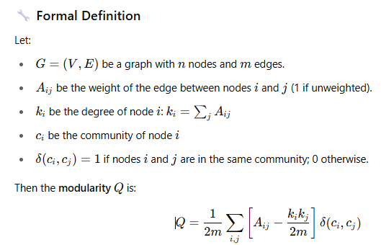
Modularity

Slide 29
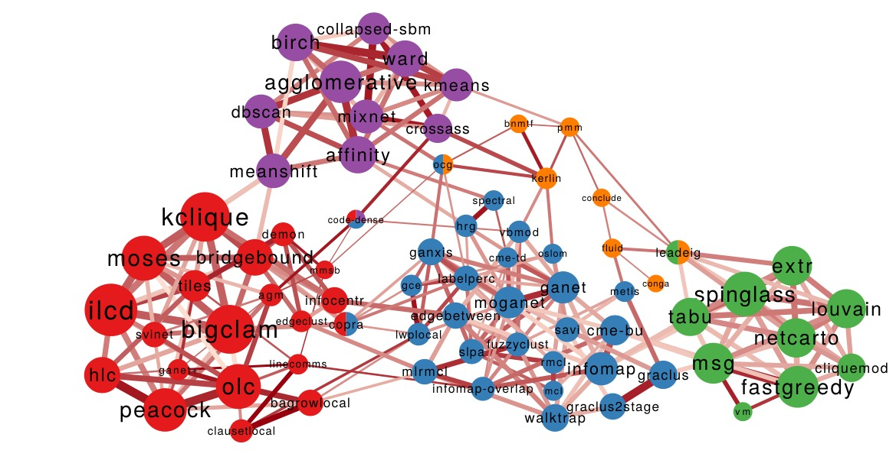

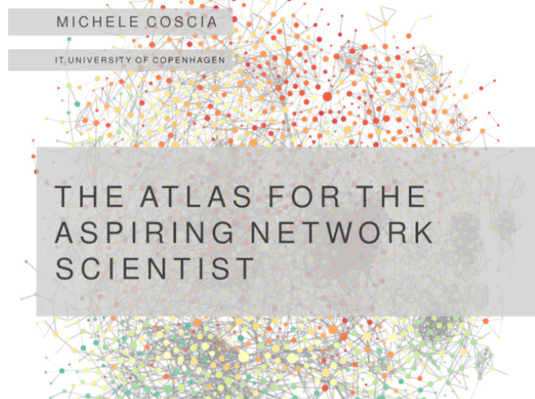
Communities of Communities
Michele Coscia
Link to Model

Slide 30
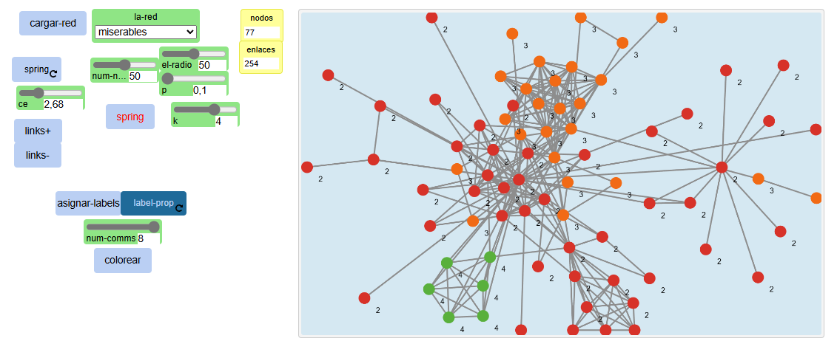
Un Algoritmo
Label Propagation
Link to Model

Slide 31
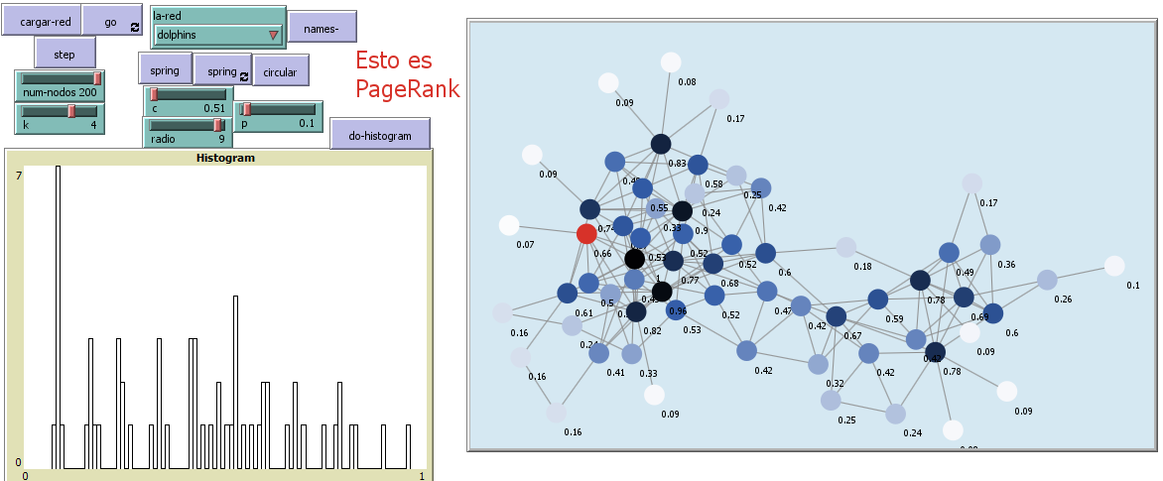
Un Algoritmo
Random Walk
Link to Model

Slide 32
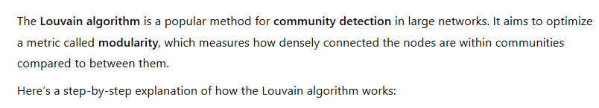
Un Algoritmo
Louvain

Slide 33
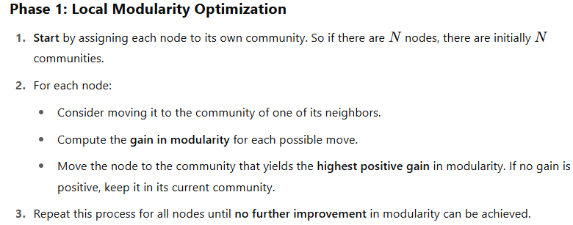
Un Algoritmo
Louvain

Slide 34
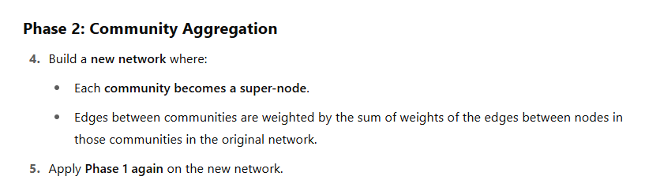
Un Algoritmo
Louvain

Slide 35
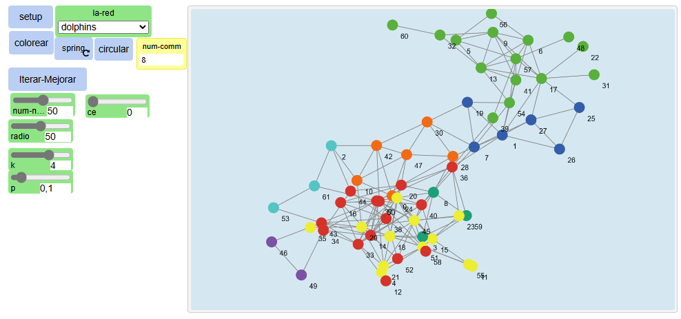
Un Algoritmo
Louvain
Link to Model

Slide 36
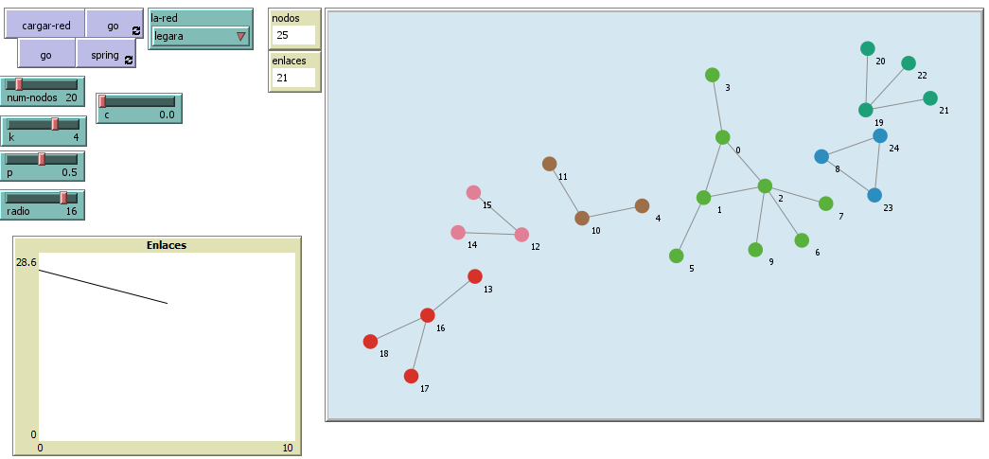
Un Algoritmo
Girvan-Newman
Link to Model

Slide 37
Communities of Communities
Michele Coscia
Link to Model

Slide 38
Good bye

Slide 40
Credits
Subject Matter Expert
Instructional Designer
Jorge Alfonso Meléndez Acuña
Angela Maria Arboleda Restrepo
Subject Matter Expert
Graphic Designer
Luis Fernando Niño Vásquez
Tania Valentina Flórez Rincón
First version
Date: April 2025

